Slide 1

Query Optimization - Indexes
Introducing Indexes
TEXT
TEXT

Slide 2

Scenario
Consider a high-volume table Transactions having records of cities such as London, Mumbai, Paris, etc.
01
02
There are many records of each city.

Slide 3
Without Indexing
Select * from Transactions where City = ‘London’;

Slide 4
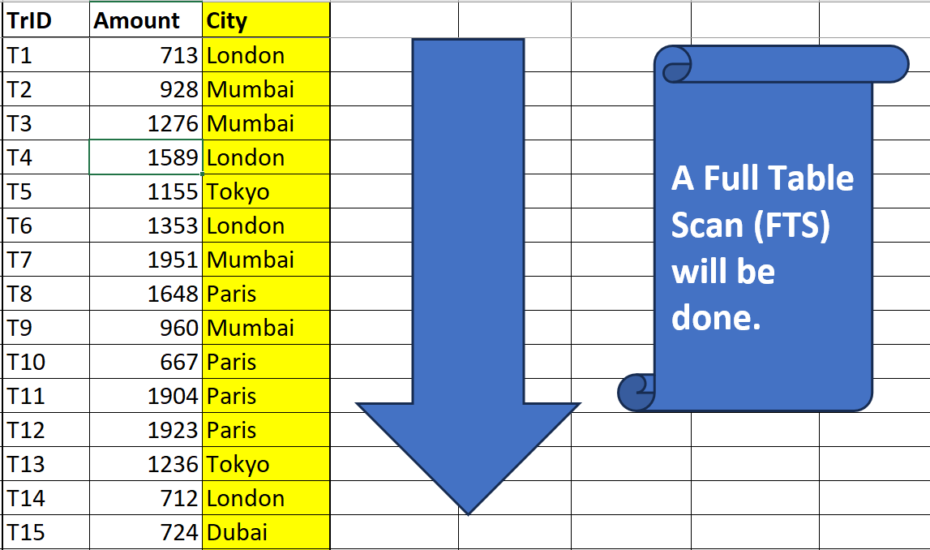
  All rows get scanned………
  Big time-consuming process………

Slide 5
With Indexing
Consider that the City column is Indexed!!!
And the same select statement is executed.
Select * from Transactions where City = ‘London’;

Slide 6
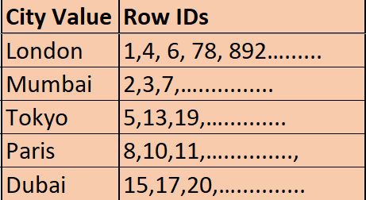
  A binary table gets created at the time of index creation.
  It keeps track of row ids of each city
A Full Table Scan (FTS) gets eliminated!!
Only selective rows are scanned!!

Slide 7
Advantage of Indexing
The data retrieval of a select statement will become fast!!
It also can avoid Disk Sorts!!

Slide 8
More about Index table – Part 1
After creating the index, later when new records get added, or some records get deleted, or some records get updated then the index table gets auto refreshed!!
01
02
Caution → Index table occupies space.

Slide 9
More about Index table – Part 2
Caution →When DML happens in the main table then the index table first gets refreshed and then the main table gets refreshed. This can slow down Bulk DML.
03
Caution → Index is of no use if the select statement is retrieving more than 80% of records.
04

